Slide 1



Unified Network Management
Automation, Visibility and Security
Pete Palazzo – IT Director @ South Euclid Lyndhurst Schools
Ben Sterley – Director of Engineering @ Laketec
Phil Wightman – Sr. Systems Engineer @ Laketec (Aruba ACMX/ACCX/ACDX/AMFX #69)
Mike Trappe – SLED Account Manager @ Laketec

Slide 2
Not a Sales Pitch.

Slide 3

BUY FROM US!

Slide 4
THIS STUFF IS REAL
LY AWSOME

Slide 5
Overview
South Euclid Lyndhurst School District

Slide 6
Background
2013
Avaya SPB
Switching, Ruckus Wireless, Cisco Firewalls
2014
Palo Alto Firewalls
2015
Aruba Clearpass for Authentication
2016
Aruba Instant Wireless & Airwave Management
2017
Aruba Controllers & Additional AP’s
2018
Need to Upgrade Switches

Slide 7
Worked, but could be better

Slide 8
What to do?

Slide 9
We Chose .

Slide 10
Architecture Deep Dive

Slide 11
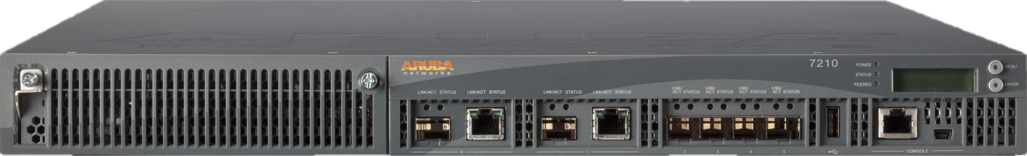

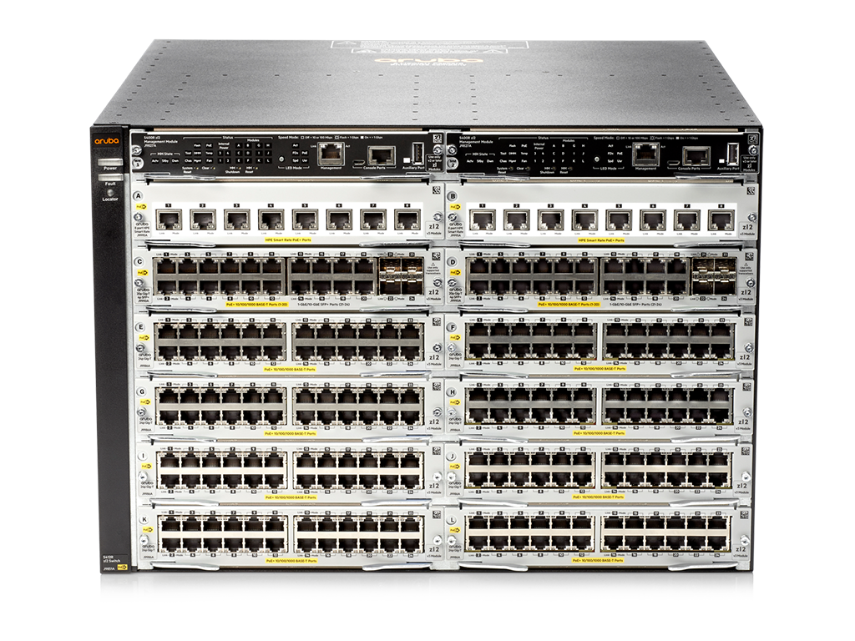
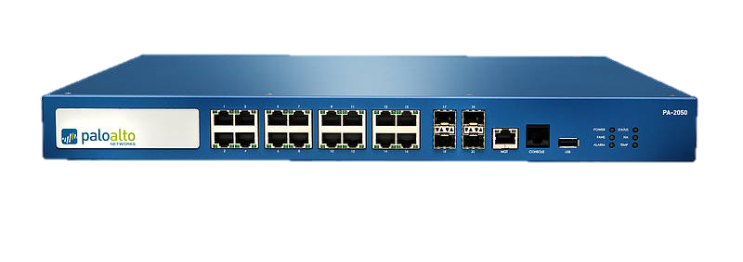
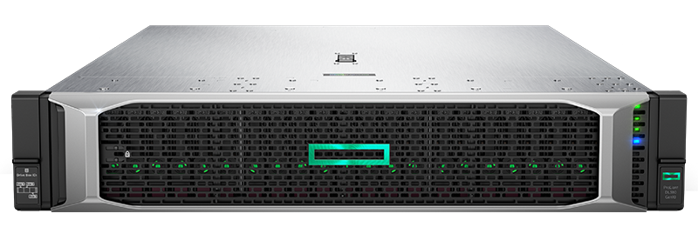

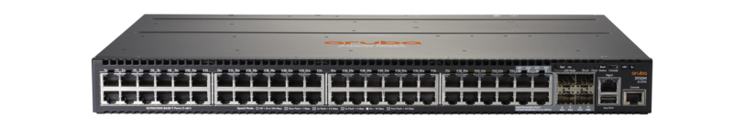


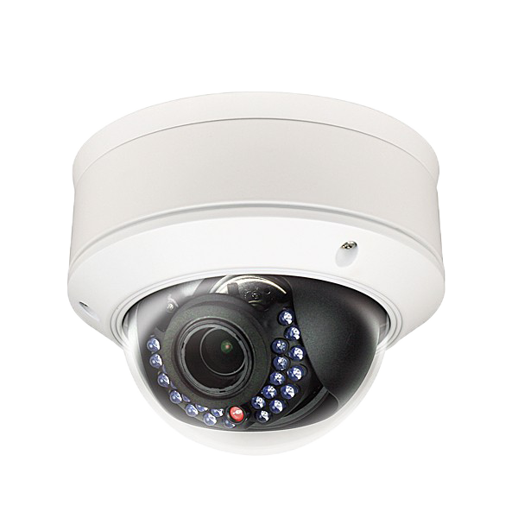
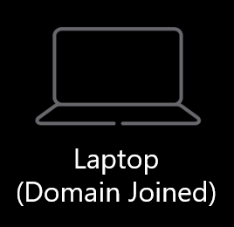
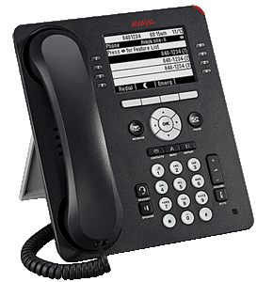



Data Center (High School)
Wireless Cluster
Authentication
Wired Cluster
Virtual Machines
Aruba Controllers
(Wireless)
Aruba Controllers
(Wired)
Aruba
Mobility Master
Aruba
Clearpass
Aruba
AirWave
Active Directory
TAG/TRUNK ALL VLAN’s
Palo Alto Firewall
VMware Virtual Environment
Aruba 5412R Chassis
GRE Tunnel
GRE Tunnel
NO TAGGING &
TRUNKING
Active-Active
(Synchronized)
Internet
DR Site
IDF / TR Example
FULLY DYNAMIC VLAN & ACL ASSIGNMENT BASED ON ROLE
VMware Virtual Environment
Google Auth
Aruba 2930M Stack
Aruba AP
PROFILING & AUTHENTICATION DETERMINE ROLE
FULLY DYNAMIC VLAN & ACL ASSIGNMENT BASED ON ROLE
Aruba
Clearpass 2
Active Directory
IP Camera
Personal
Laptop
IP Phone
HVAC Controllers
VLAN 40
VLAN 20
VLAN 30
VLAN 10
Virtual Machines
Chromebook
Domain Joined Laptop
VLAN 30
VLAN 30
VLAN 50

Slide 12
What did we Learn?
What would we do differently?

Slide 13
Questions?

Slide 14
THANK YOU
Visit us @ Laketec.com

